Slide 1
Visual NOTAM
By: Abhilaash Velamati
Intern at CGH Technologies

Slide 2
About Me
Rising Junior
Thomas Jefferson High School for Science and Technology
Interested in
  Mobile App Development
  Artificial Intelligence
  Robotics & UAV Systems

Slide 3
Experience
Java
Android SDK
Objective C Robotics
Mindstorm
Picaxe
Liberty Basic
HTML

Slide 4
Internship
Started: 8/6/2014
Project Scope
  Develop native android NOTAM search app
  Display graphical NOTAMs (Display NOTAMs on map)
  Utilize data from NDS Web Service
  Format NOTAMs to be easily read

Slide 5
Progress
Three weeks
  Understood Android app framework
  Learned design process
  Understood Graphical NOTAM objectives
  Preliminary design of an Android NOTAM search app

Slide 6
Challenges
Complexity of Android framework
Designing compelling user interfaces
Initial complexity of Graphical NOTAMs
Multiple threads

Slide 7
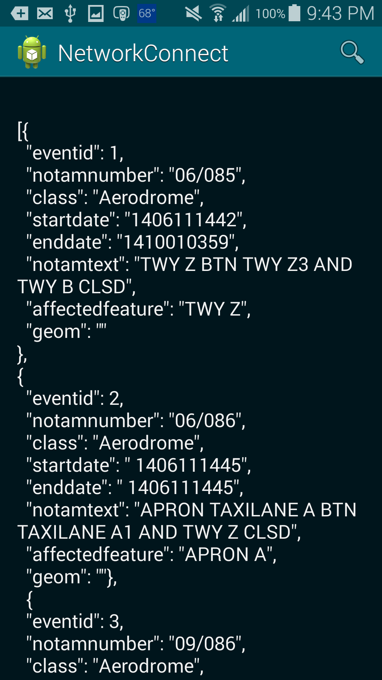
Initial Design for app
  Directly read the JSON file from assets
  Did not parse the JSON file at all
  Implemented a non-functional search bar
  Default background color and default text color

Slide 8
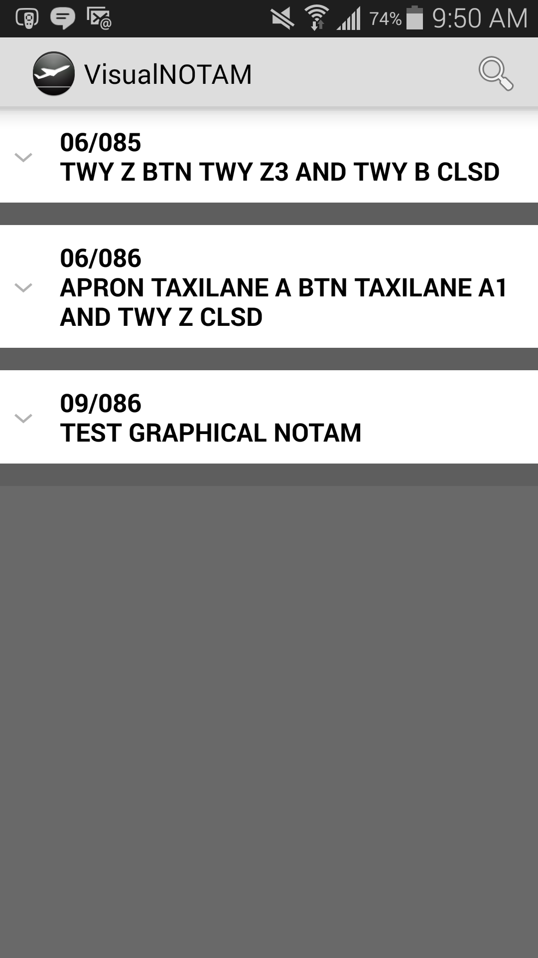
Design after one week of developing
  Implemented a view that could expand and close when clicked
  However, did not look optimal
  Able to receive data from network
  JSON is parsed, however, information is still displayed in a unwanted manner
  Learned the basics of adapters
  Renamed application

Slide 9
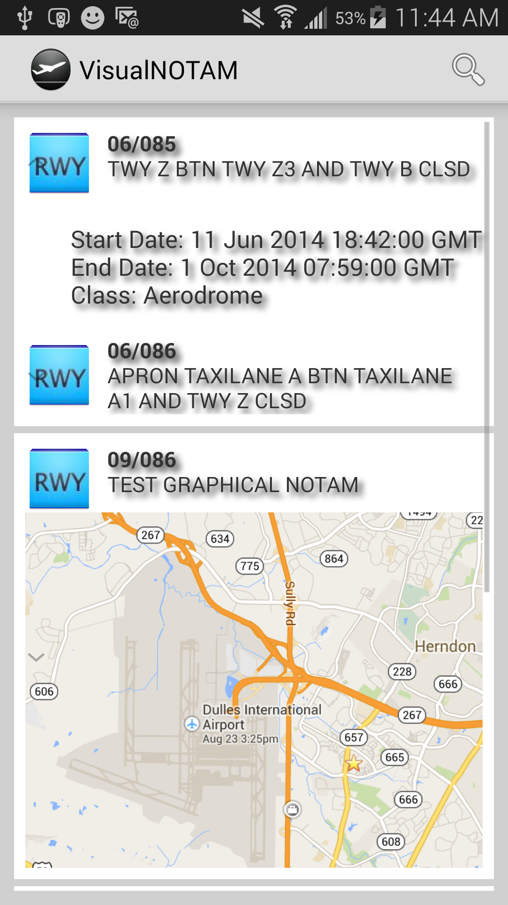
Design halfway through Week 2
  Now displays images from website
  Added shadows to text, however, needed it on text-view
  Learned more about adapters
  Added small image on the side to display the issue in a more user friendly manner
  Parses text and makes it easier to read

Slide 10
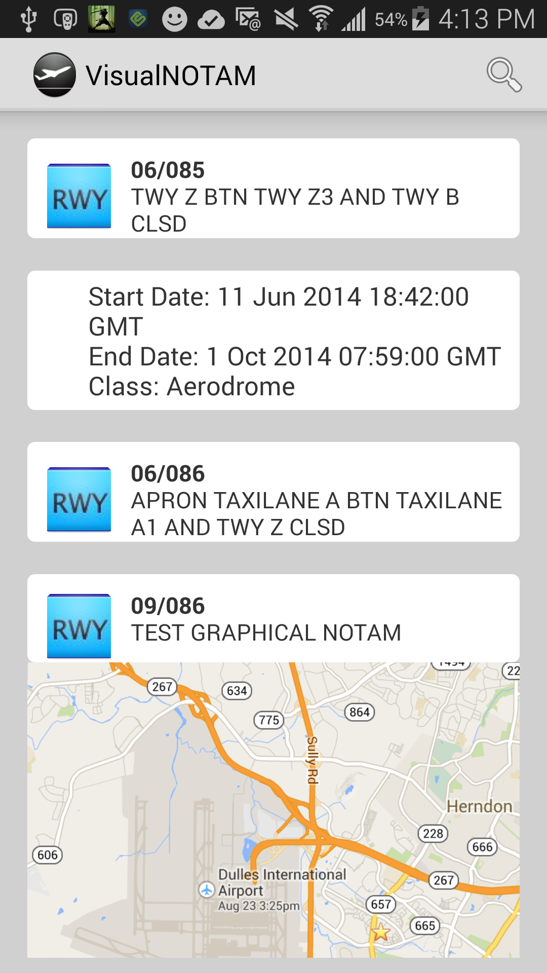
Design after week 2 of developing
  Rounded edges for text-views
  Performance improvement
  Less memory space because deleted unnecessary files
  Optimized data retrieval
  Font is now changed to Android’s Roboto

Slide 11

Current Application
  Uses search bar
  Needs a new home screen
  Allows for searching of any airport only using ID
  In the future, need implementation for people to search for the airport name to make it easier to use

Slide 12
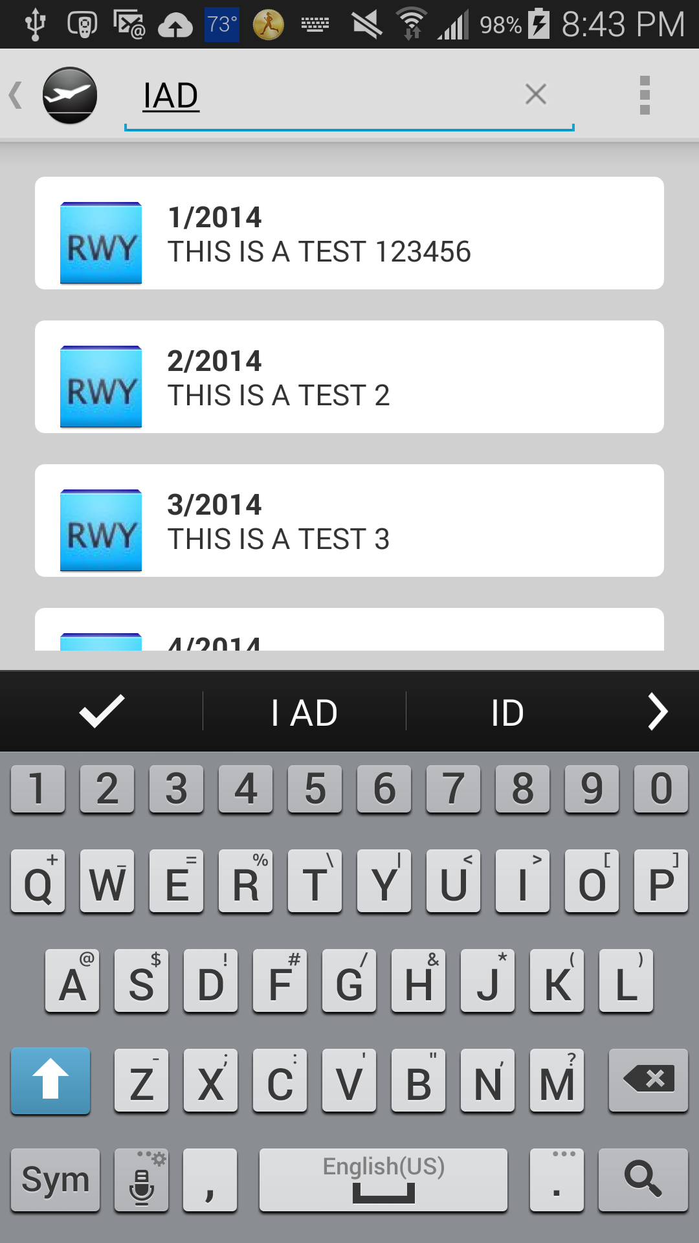
Current Application
  Search bar functional
  Downloads information from a more secure database
  For the future:
    Needs up-to-date data
    Needs to be able to display NOTAM information on a dynamic map using longitude and latitude data

Slide 13
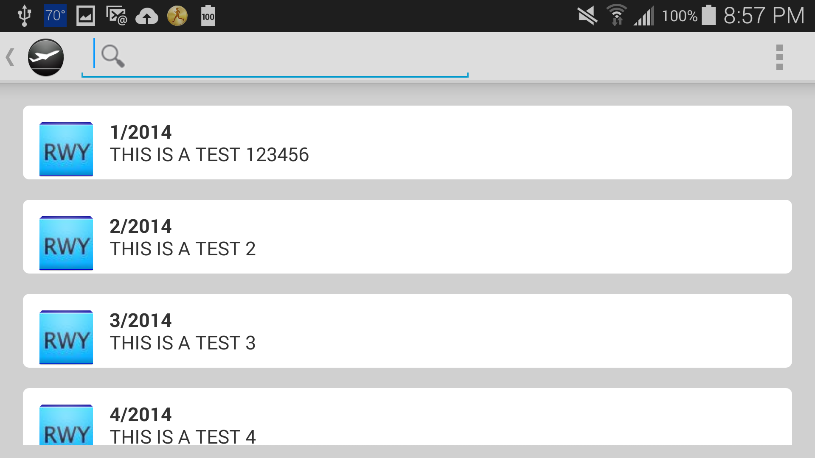
Horizontal View
Note: This is all test data, not real data, and is not a substitute for legitimate NOTAMs

Slide 14
Next Step
Complete search implementation
Display NOTAMs on map using shapes
More user friendly
Improve performance
Release on Google Play Store

Slide 15
Contact Information
Contact Information
  Name: Abhilaash Velamati
  Email: Abhilaash.Velamati@Gmail.com
  Phone Number:
    Cell Phone Number: 757-672-2244
    Home Phone Number: 703-449-1008
  App Name: Visual NOTAM

Slide 16
Thanks for Listening
Special Thanks to:
  Prakash Manglanathan (Mentor and managing database)
  Ming Huang (Secondary Mentor)
  Madhu Velamati (Reviewing app)
  James Murnahan (Accepting me into the internship program)
  Paul Cobb (Reviewed app)
  Murali Kuppoor (Reviewing app)

